Slide 1

Multi-DICE R package: Hierarchical co-demographic inference for comparative phylogeography
August 30, 2019
CompPhylo Workshop
Alexander T. Xue
Simons center for quantitative biology
Cold spring harbor laboratory
XanderXue@gmail.com; http://www.xanderxue.com

Slide 2
Co-demography
How do organisms collectively respond, spatially and temporally, to climate, landscape, and anthropogenic change?
How do organisms collectively respond, spatially and temporally, to climate, landscape, and anthropogenic change?

Slide 3
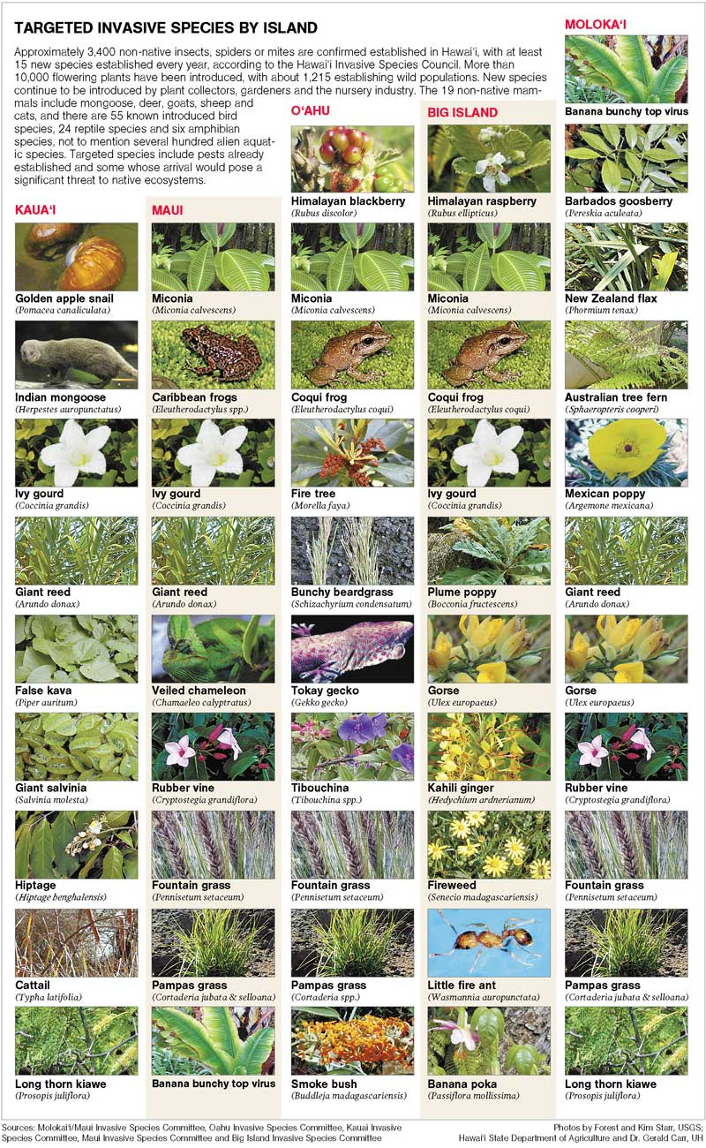

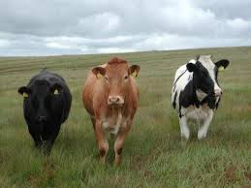
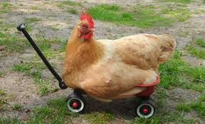

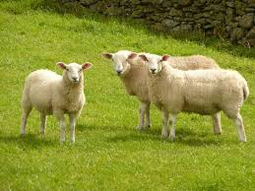
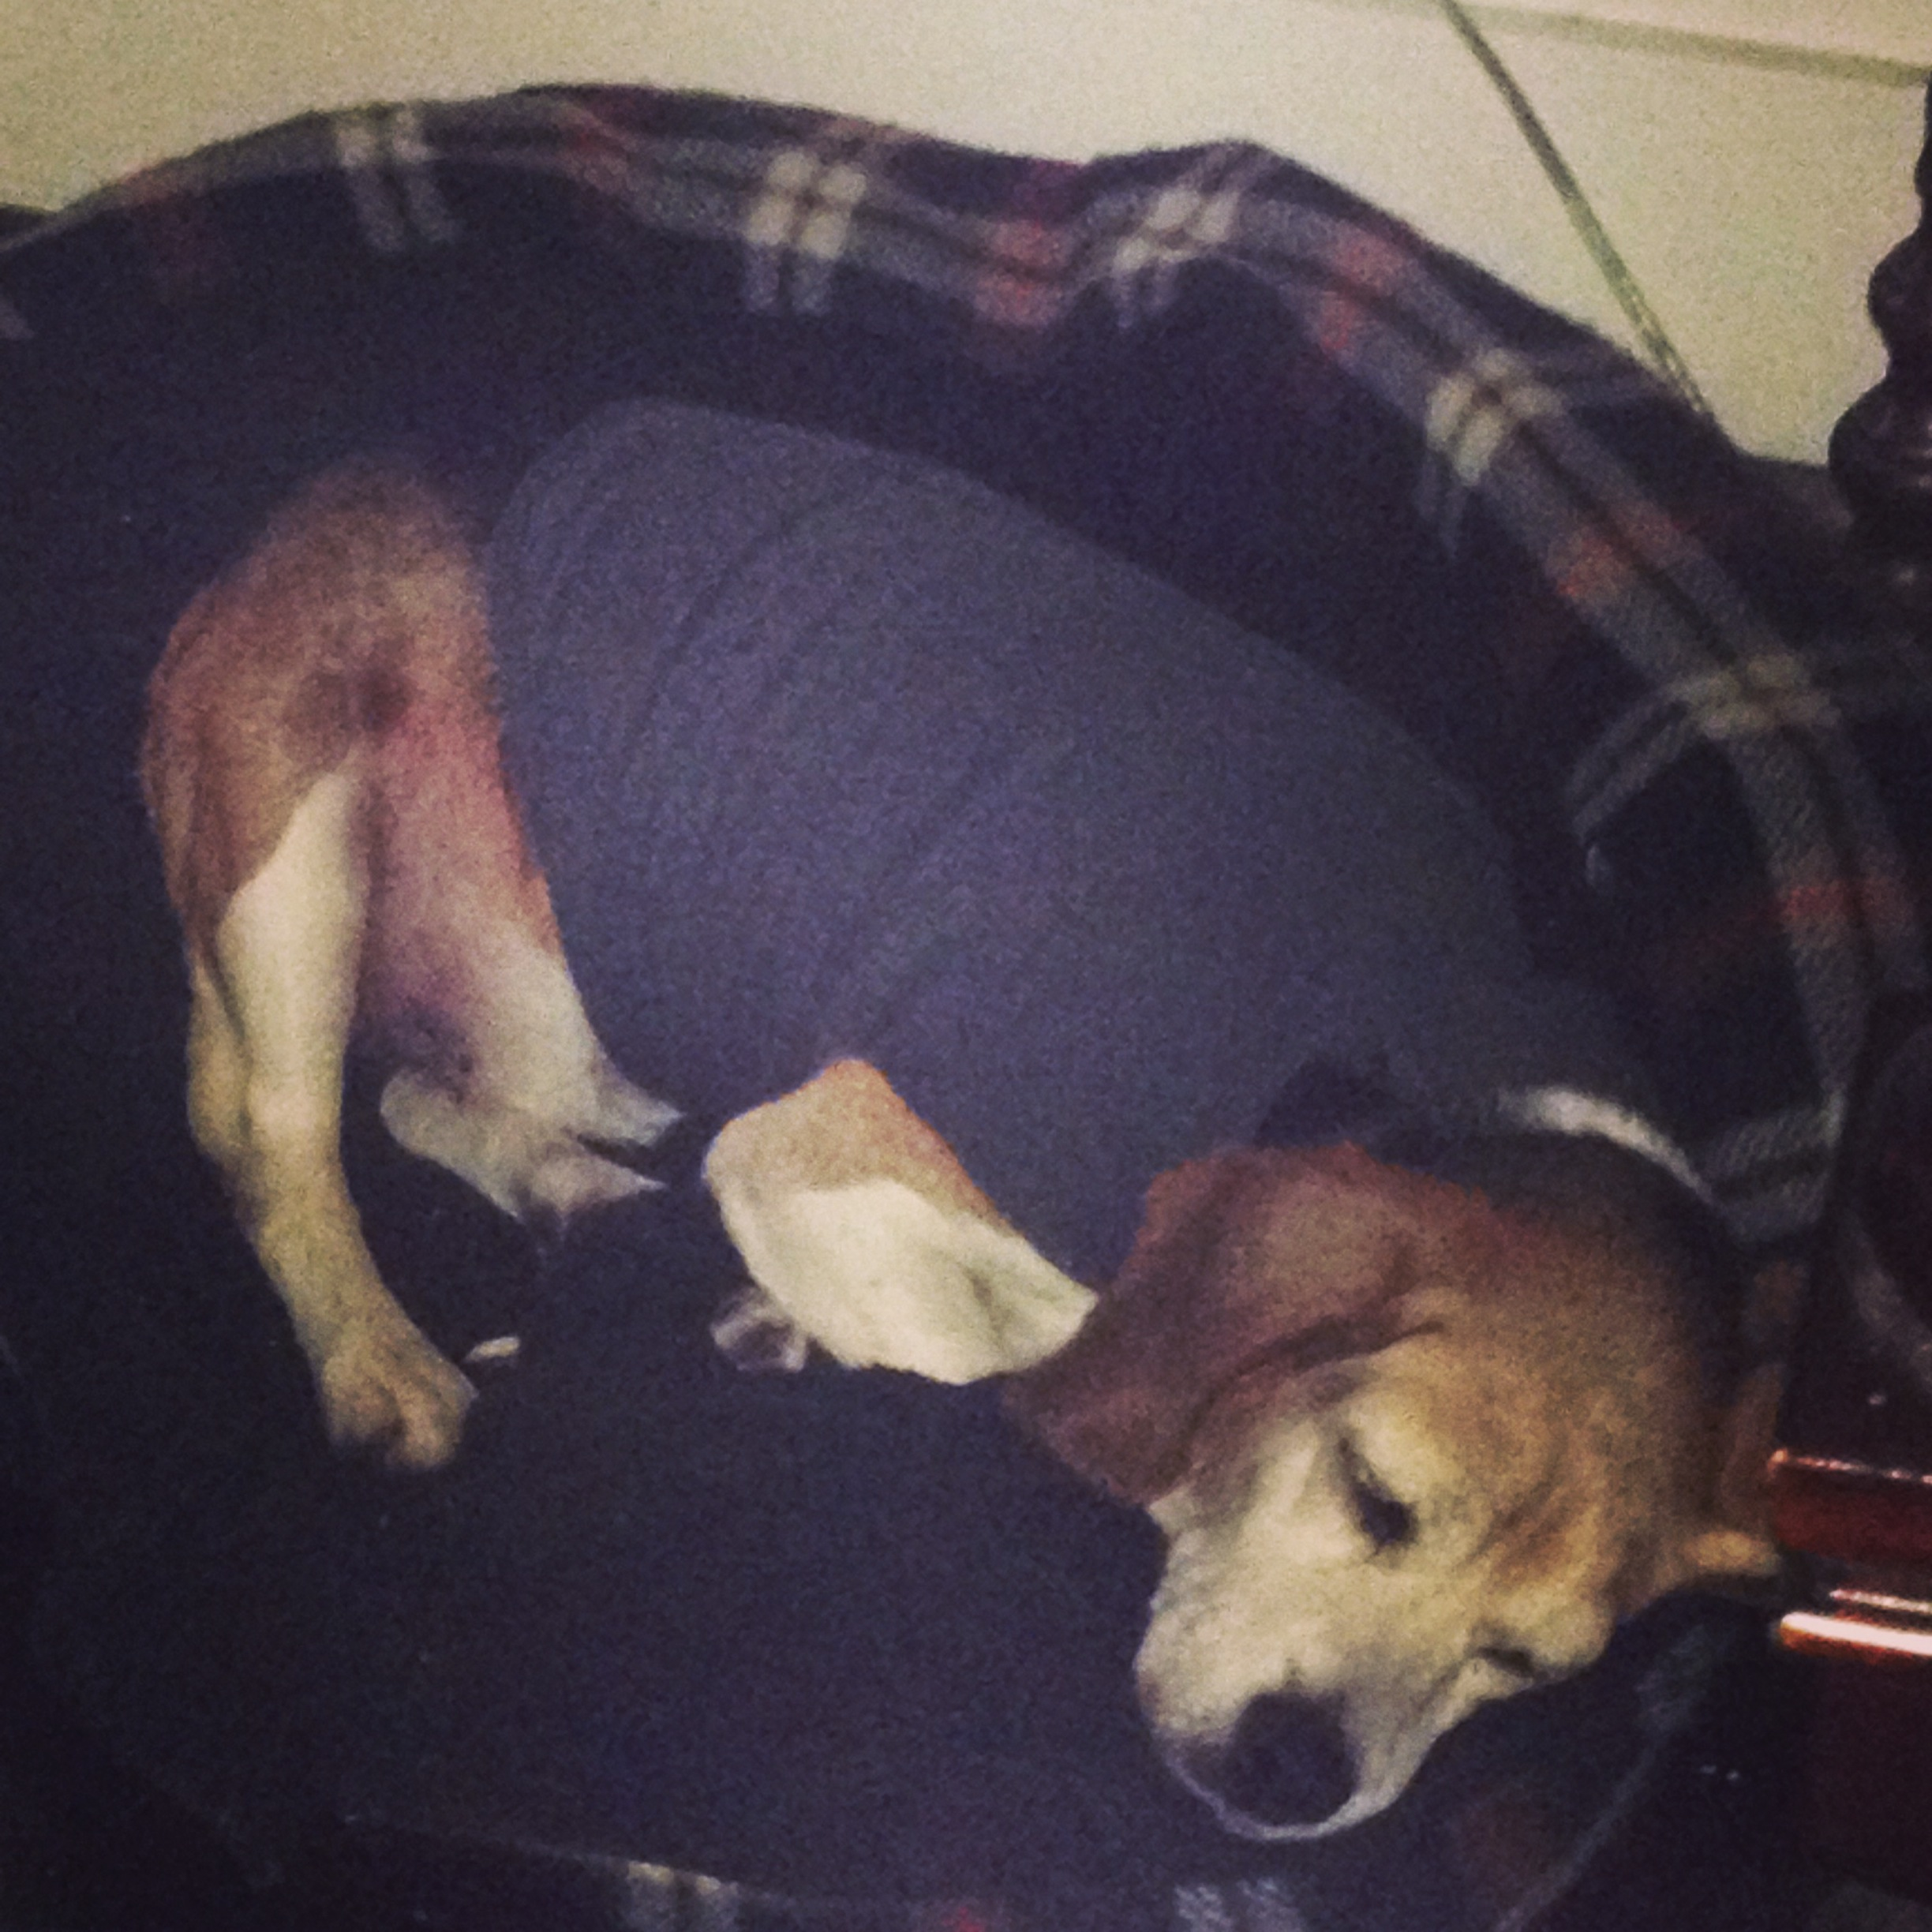
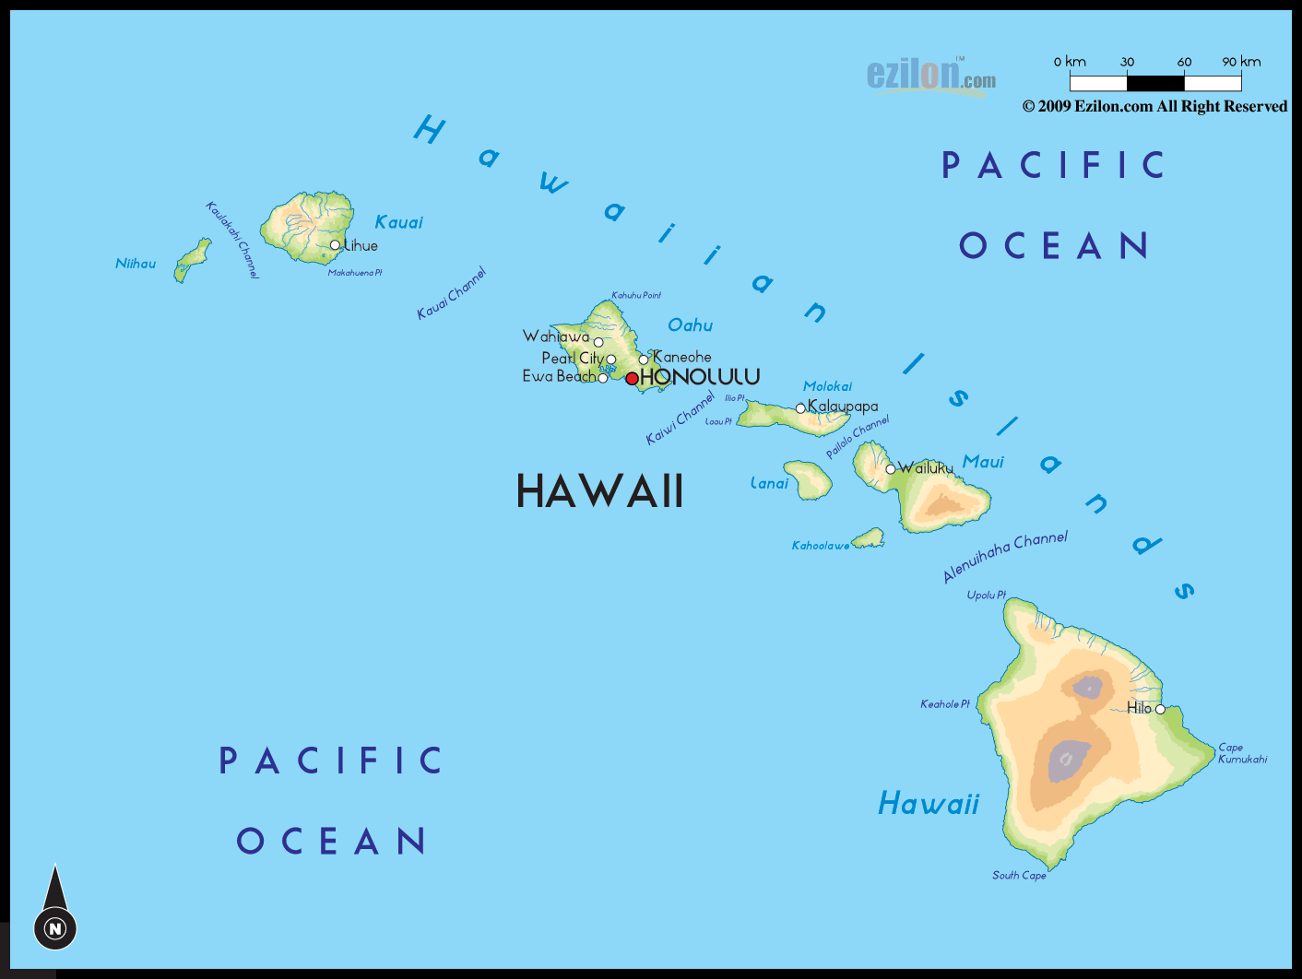
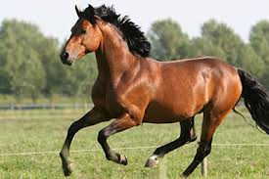
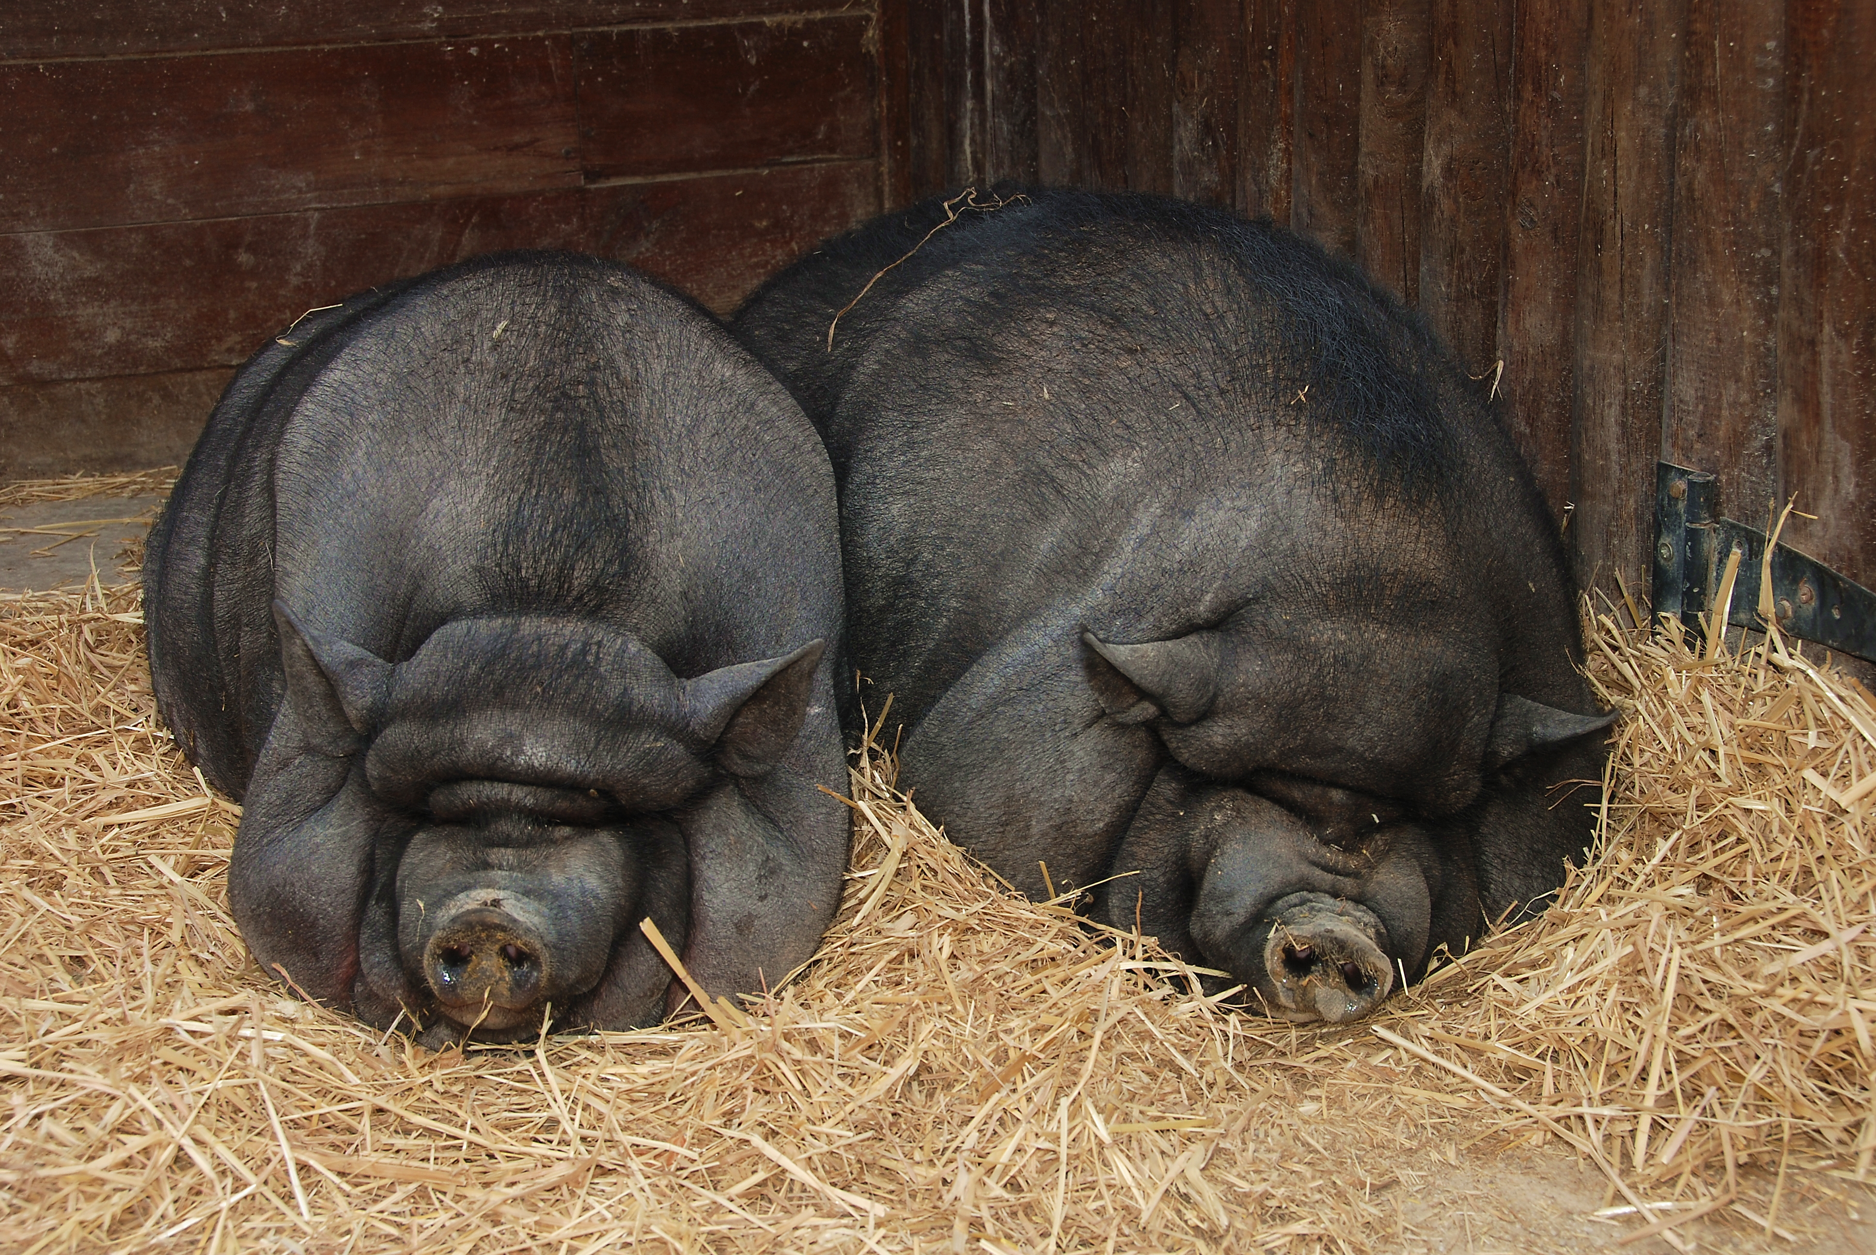
Co-evolutionary dynamics
Invasion
Domestication
Pathogen Vector Host
Notes:
This kind of question can be applied to many contexts

Slide 4
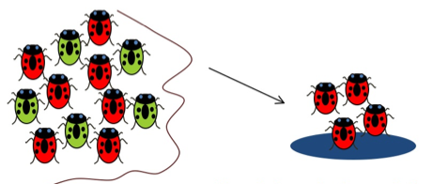
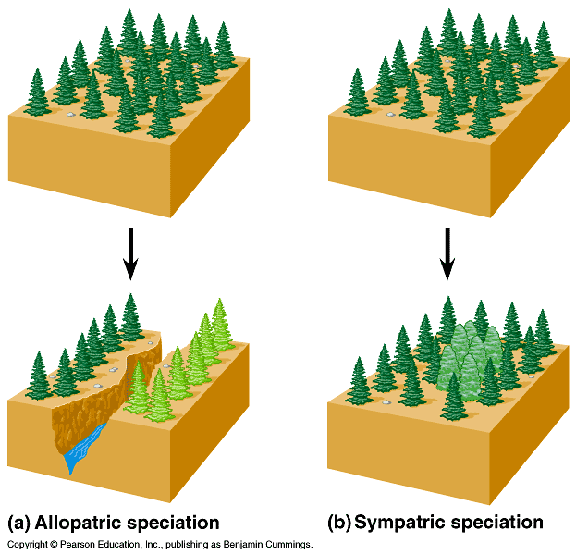

Notes:
Temporal patterns imply spatial patterns

Slide 5
How can we distinguish between competing co-demographic scenarios causing current day distribution of diversity?
Individually calculate and compare summary statistics of genetic data
Not directly testing hypothesis
Cannot infer parameters
May lack identifiability
Model-based inference
Hierarchical model of co-demographic history
Model of simulating data
Model of statistical inference
Notes:
Methodological perspective

Slide 6
Co-demographic Model
Hypothesis of multi-taxa evolutionary history is converted into testable hierarchical co-demographic model
Data are simulated under hierarchical co-demographic model, and thus subject to assumptions of the model

Slide 7
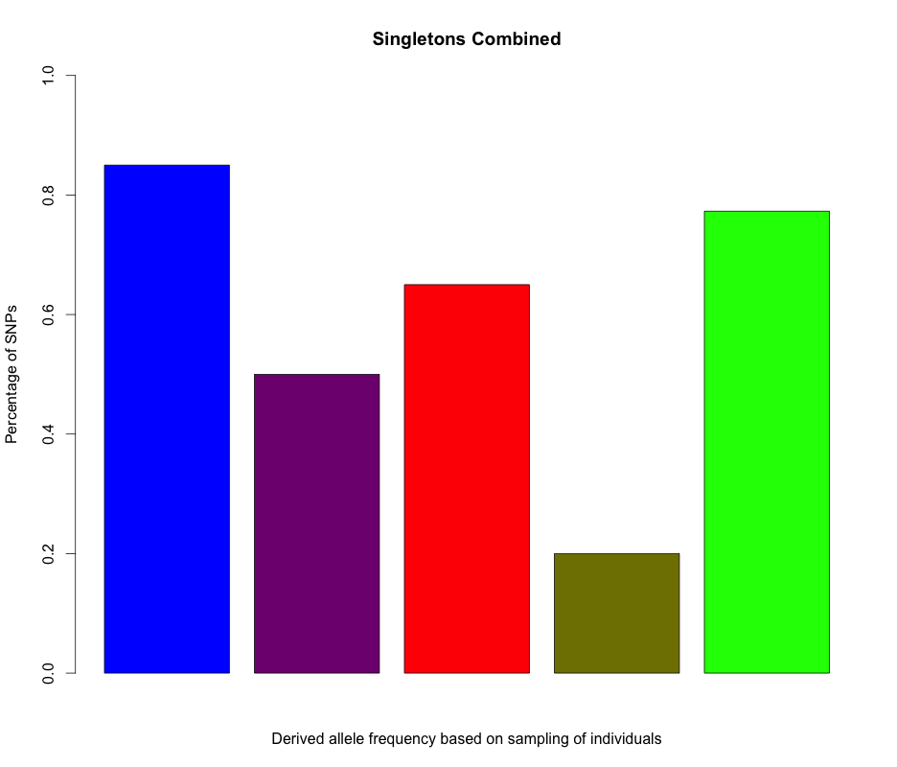
Single-population Models
Past
τ₃
ε₃
τ₂
ε₂
τ₁
ε₁
N_{E}
N_{E}
N_{E}
Present

Slide 8
Single-population Hierarchical Co-demographic Model
Past
ε₆
ε₇
ε₈
ε₄
ε₅
ε₁₀
ε₁
ε₂
ε₃
ε₉
N_{E}
₁
N_{E}
₂
N_{E}
₃
N_{E}
₄
N_{E}
₅
N_{E}
₆
N_{E}
₇
N_{E}
₈
N_{E}
₉
N_{E}
₁₀
Present
Hyperparameters/Parameter Summary
ψ # of synchronous pulses
ζ₁,…, ζ_{ψ} proportion of single- populations within pulse
τ_{s,1},…, τ_{s,ψ} time of synchrony
Nuisance Parameters
τ_{i} vector of idiosyncratic times
ε expansion magnitude
N_{E} current effective population size of haploids

Slide 9
Single-population Hierarchical Co-demographic Model
Past
₁
₂
₃
₄
₅
₆
₇
₈
₉
₁₀
Present

Slide 10
Single-population Hierarchical Co-demographic Model
Past
₁
₂
₃
₄
₅
₆
₇
₈
₉
₁₀
Present

Slide 11
Single-population Hierarchical Co-demographic Model
Past
₁
₂
₃
₄
₅
₆
₇
₈
₉
₁₀
Present

Slide 12
Single-population Hierarchical Co-demographic Model
Past
₁
₂
₃
₄
₅
₆
₇
₈
₉
₁₀
Present

Slide 13
Hierarchical Modeling with Hyperpriors
50,000 kya
100% of species synchronously expanding
For ALL species
1.0
10,000
100,000
0.0
0.4
0.6
0.8
1.0
Time of expansion
(kya)
Species-specific prior
Proportion of species in a particular time pulse of expansion
Hyper-prior
(for five species)
Beaumont (2010) Annu. Rev. Ecol. Evol. Syst.

Slide 14
Hierarchical Modeling with Hyperpriors
10,000 kya
50,000 kya
80% of species synchronously expanding
For 4/5 species
For 5th species
0.8
10,000
100,000
0.0
0.4
0.6
0.8
1.0
Proportion of species in a particular time pulse of expansion
Hyper-prior
(for five species)
Time of expansion
(kya)
Species-specific prior
Beaumont (2010) Annu. Rev. Ecol. Evol. Syst.

Slide 15
Exercise 1

Slide 16
Exercise 2

Slide 17
Population-pair Models

Slide 18
Population-pair Models

Slide 19
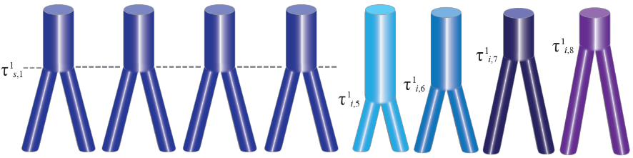
Population-pair Hierarchical Co-demographic Model
Past
Present
ζ = 0.5 (i.e. half co-diverge synchronously)

Slide 20
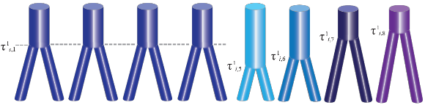
Exercise 3

Slide 21
Data Generation
Data are simulated under hierarchical co-demographic model to compare with observed data
Generating summary statistics that sufficiently represent data increases computational efficiency, especially for genomic-scale sampling

Slide 22
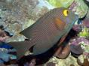
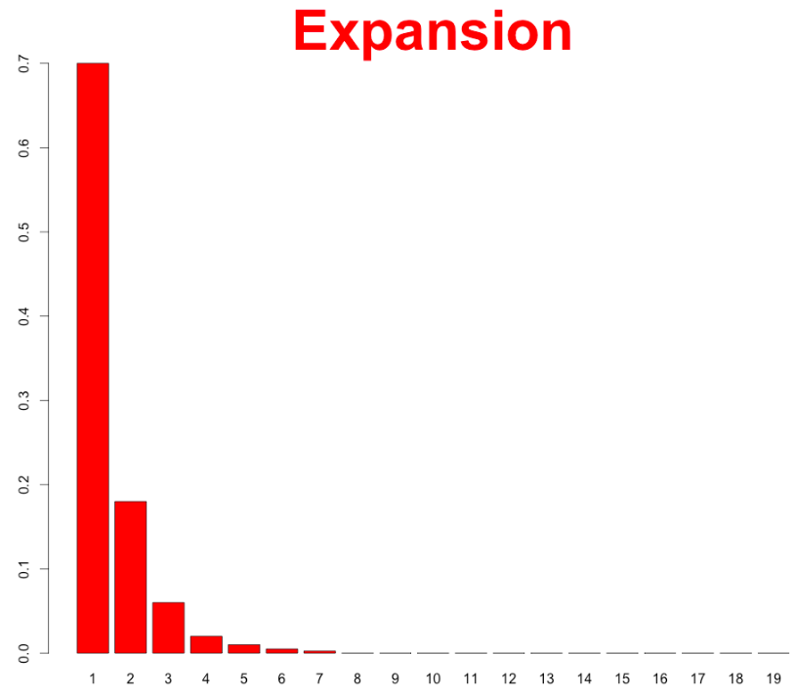
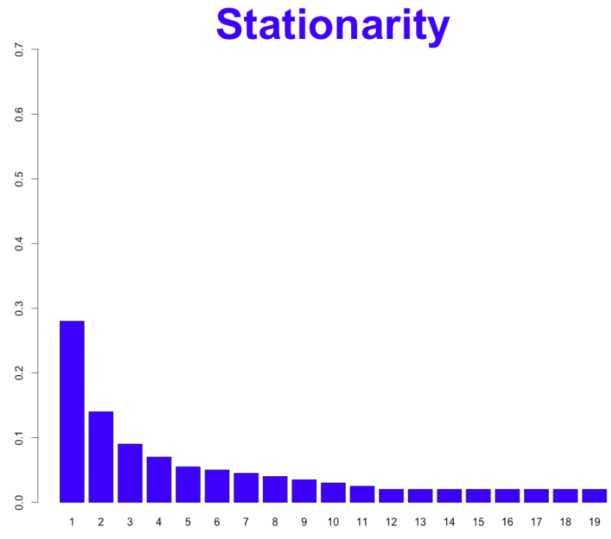
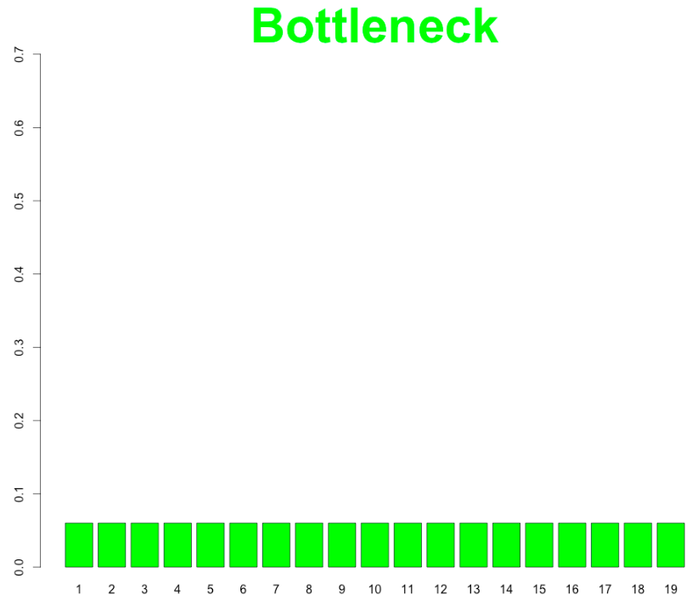
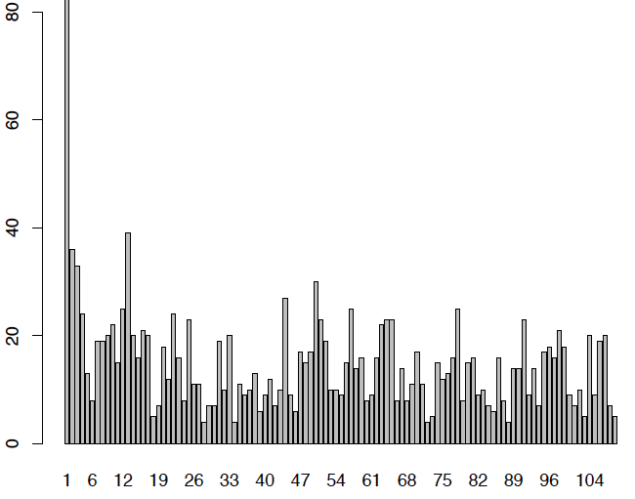
Site Frequency Spectrum (SFS)
Individual 1
Individual 2
Individual 3
Individual 4
Individual 5
G
G
C
G
G
G
G
C
G
G
A
A
A
A
A
T
A
A
A
A
Let’s say the derived allele is T
Then the derived allele frequency for this site is .1, or 1/10.
# SNPs
aka “singleton”
0 1 2 3 4 5 6 7 8 9 10
# Individuals (Derived Allele Frequency)

Slide 23
Joint/Multi-SFS
Population 1
Individual 1
Individual 2
Individual 3
Individual 4
Individual 5
A
A
A
A
A
T
A
A
A
A
1/10
Individual 1
Individual 2
Individual 3
Individual 4
Individual 5
T
A
T
A
A
A
A
T
A
A
3/10
Population 2

Slide 24
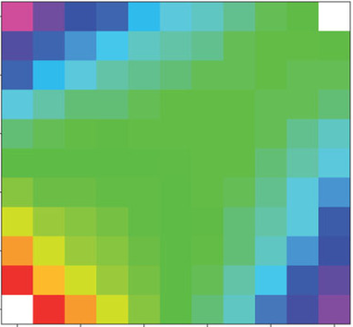
Joint/Multi-SFS
Population 1
1
0 2 3 4 5 6 7 8 9 10
1
0
1
2
4
5 6
7
8
9
10
- .4 .18 .01 .01 .01 .01 .01 .01 .01 .01
.2 .01 .001 .005 .01 .01 .01 .01 .01 .01 .01
.001 .001 .001 .001 .001 .001 .001 .001 .001.001 .001
.001 .001 .001 .001 .001 .001 .001 .001 .001.001 .001
.001 .001 .001 .001 .001 .001 .001 .001 .001.001 .001
.001 .001 .001 .001 .001 .001 .001 .001 .001.001 .001
.001 .001 .001 .001 .001 .001 .001 .001 .001.001 0
0 0 0 0 0 0 0 0 0 0 0
0 0 0 0 0 0 0 0 0 0 0
0 0 0 0 0 0 0 0 0 0 0
0 0 0 0 0 0 0 0 0 0 -
1/10
3
3
Population 2
3/10
Sousa & Hey (2013) Nature Reviews Genetics.

Slide 25
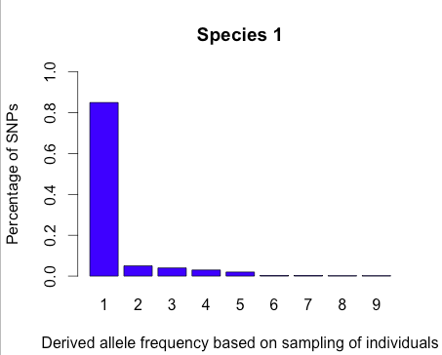
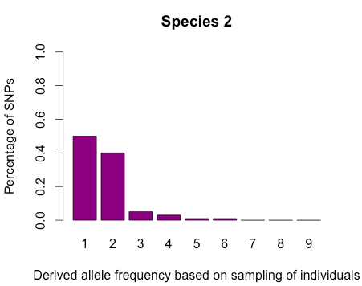
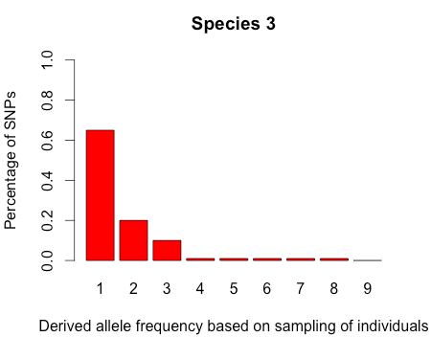
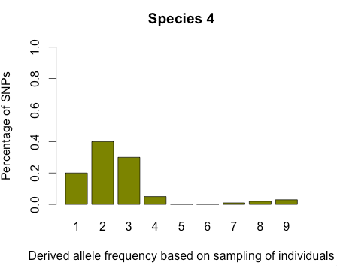
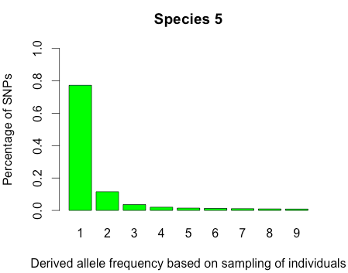
Aggregate SFS (aSFS)
Species 1 Species 2 Species 3 Species 4 Species 5
According to a typical RAD-seq dataset
(i.e. order of thousands of SNPs)

Slide 26
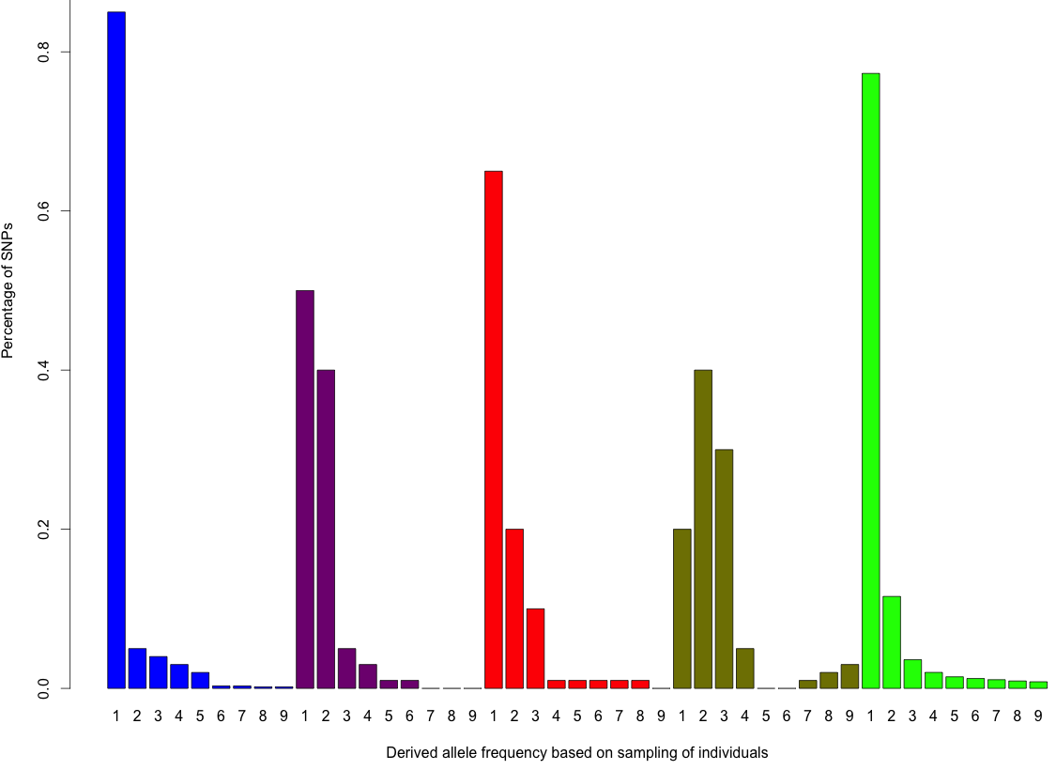
Aggregate SFS (aSFS)
KEY
Species 1
Species 2
Species 3
Species 4
Species 5

Slide 27
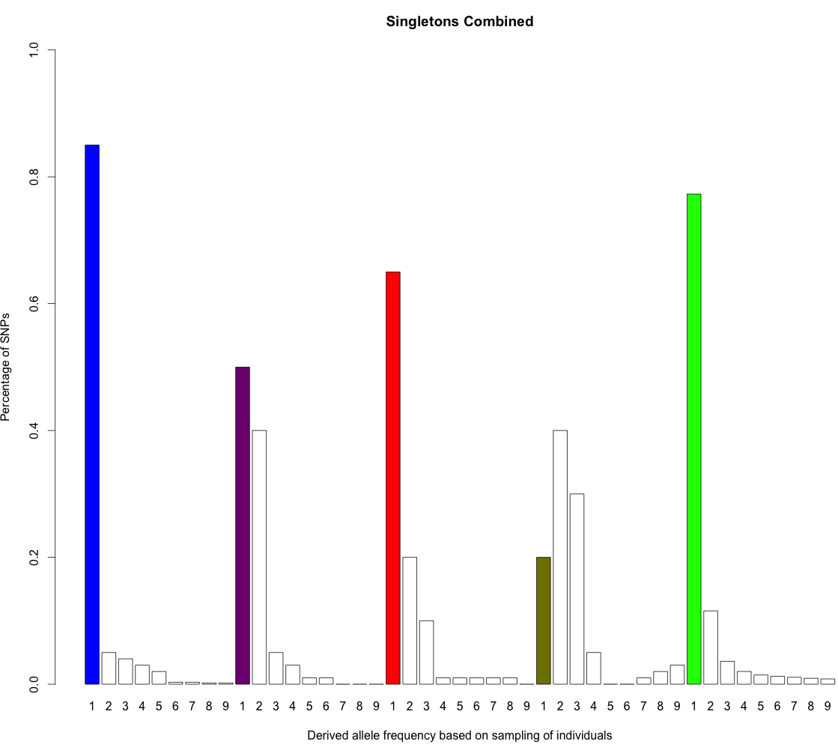
Aggregate SFS (aSFS)
KEY
Species 1
Species 2
Species 3
Species 4
Species 5
Singletons Combined

Slide 28
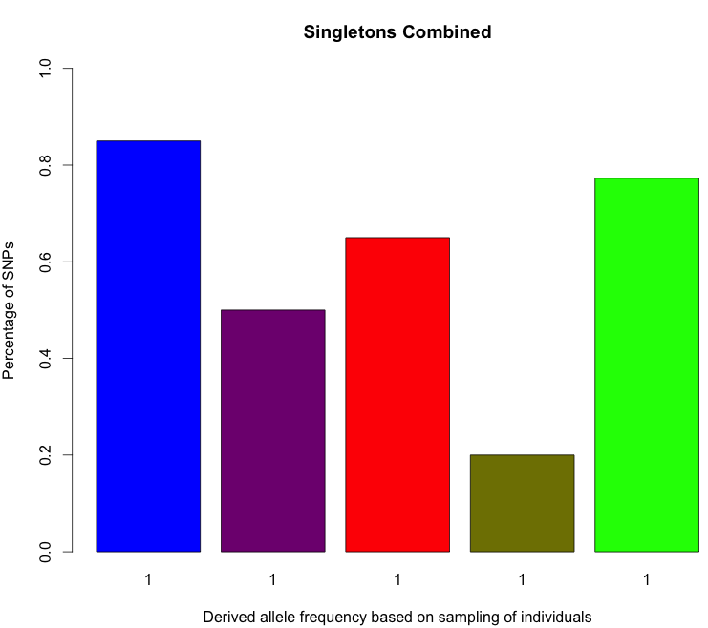
Aggregate SFS (aSFS)
Singletons Combined
Species 1
Species 2
Species 3
Species 4
Species 5

Slide 29
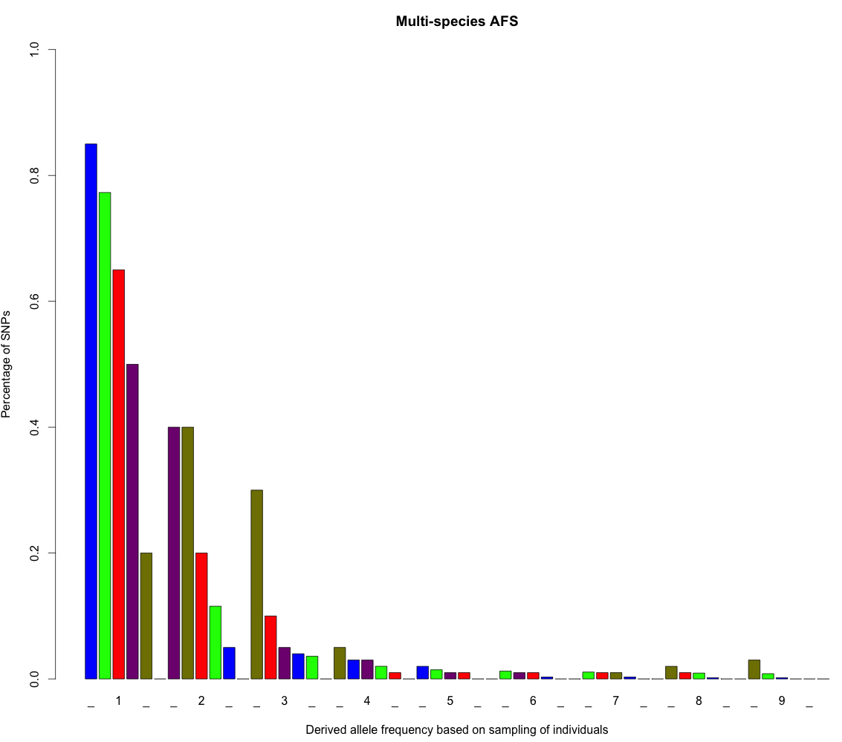
Aggregate SFS (aSFS)
Species 1
Species 2
Species 3
Species 4
Species 5

Slide 30
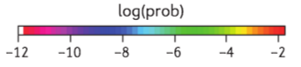
Aggregate Joint-SFS (ajSFS)
Population 1
0 1 2 3 4 5 6 7 8 9 10
0
1
2
3
4
5
6
7
8
9
10
Population 2
Sousa and Hey (2013) Nature Reviews Genetics.

Slide 31

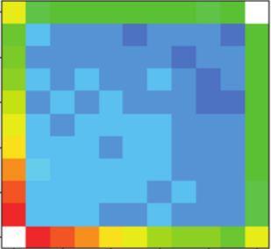
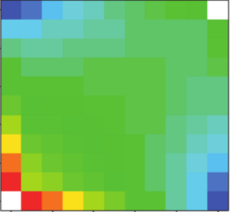
Aggregate Joint-SFS (ajSFS)
Species 1
Species 2
Species 5
Species 3
Species 4

Slide 32
Aggregate Joint-SFS (ajSFS)
Species 1
Species 2
Species 5
Species 3
Species 4

Slide 33

Aggregate Joint-SFS (ajSFS)
Species 1
Species 2
Species 5
Species 3
Species 4

Slide 34
Aggregate Joint-SFS (ajSFS)
Singletons Combined
Species 1
Species 2
Species 3
Species 4
Species 5

Slide 35
Aggregate Joint-SFS (ajSFS)
Species 1
Species 2
Species 5
Species 3
Species 4

Slide 36
Exercise 4
Species 1
Species 2
Species 3
Species 4
Species 5

Slide 37
Statistical Inference
Simulation given the hierarchical co-demographic model are compared to observed data
Hyperparameter estimates provide support for hypothesis

Slide 38
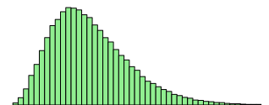
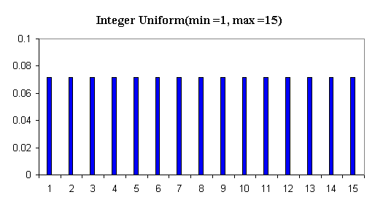
Hierarchical ABC (hABC)
Simulated aSFS (*1,000,000)
Observed aSFS
ζ
ζ
Probability Density
Parameter Value

Slide 39
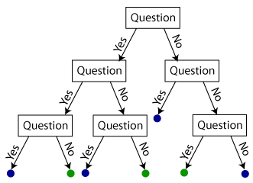
Hierarchical Random Forest (hRF)
Observed aSFS
Simulated aSFS (*1,000,000)
Not suitable for wide parameter ranges!!!

Slide 40
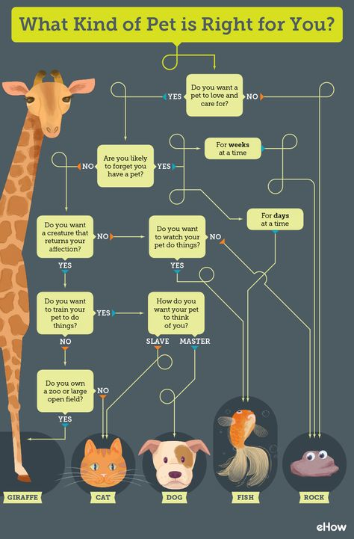
Decision Tree

Slide 41
Exercise 5

